Slide 1
Acids and Bases
Chapter 10

Slide 2
Objectives
Relate the process of ionization to the formation of acids and bases
Explain qualities of acids and bases
Compare the acidity of substances, using the pH scale and pH indicators
Use molarity and titration to determine the concentration of an acid
Contrast the concepts of strength and concentration in acids and bases
Compare general qualities of acids and bases in foods
Explain the importance of pH to physical health

Slide 3
Vocabulary
Ionization: the process of forming ions in water solution
Neutral: a solution that has an equal number of hydrogen and hydroxide ions
Acid: a substance that breaks down to release hydrogen ions in water
Base: a substance that breaks down to release hydroxide ions in water
Neutralization: a chemical reaction in which hydrogen ions from an acid react with hydroxide ions from a base to produce water
pH scale: a mathematical scale in which the concentration of hydrogen ions in a solution is expressed as a number from 0 to 14
Indicator: a substance that changes color depending on the pH
Concentration: the measure of the amount of a substance in a given unit of volume
Molarity: the number of moles of solute per liter of solution
Titration: a common method used in the laboratory to determine the concentration of an acid and base
Equivalence point: the point at which neutralization occurs
Buffers: substances that help maintain the balance of hydrogen and hydroxide ions in a solution

Slide 4
Acids and Bases Video
http://www.youtube.com/watch?v=DupXDD87oHc

Slide 5
Ionization of Water
In water, a very small portion of molecules form tiny charged particles called ions
When water ionizes, both hydrogen (H⁺) and hydroxide (OH⁻) ions are formed
H₂O ↔ H⁺ + OH ⁻

Slide 6
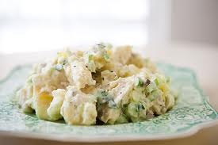
Strength of Acids and Bases
Strong acids and bases ionize completely
Strong acid example: hydrochloric acid
Weak acids and bases ionize partially
Weak acid example: Acetic acid, found in potato salad

Slide 7
Neutralization of Acids and Bases
If you add base to an acid, it adds hydroxide ions
becomes a weaker acid and raises the pH
If you add acid to a base, it adds hydrogen ions
becomes a weaker base and lowers the pH
Neutralization occurs when there are equal numbers of hydrogen and hydroxide ions

Slide 8
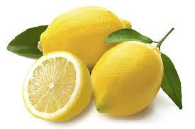
General Properties
Acids
Sour taste (ex: lemons)
Can change the colors of certain foods and flowers (ex: Hydrangeas turn blue when planted in acidic soil)
Bases
Bitter taste (ex: milk of magnesia)
Slippery (ex: soap, ammonia)

Slide 9
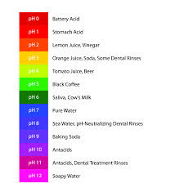
pH Scale
Acids: pH between 0 and 7
Lower pH numbers indicate stronger acid
Bases: pH between 7 and 14
Higher pH numbers indicate stronger bases
Neutral: pH of 7
Determined by indicators and meters
Ex: litmus paper soaked in anthocyanin

Slide 10
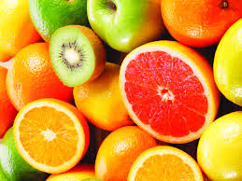
Acids and Bases in Foods
Most bases in foods are strong, but with low concentration, so they are safe
Most acids in foods are weak acids, so they are generally safe
May sting eyes or open cuts (ex: citrus fruits)
Very few foods have pH of exactly 7
Except distilled water
pH balance is essential in making baked goods rise

Slide 11
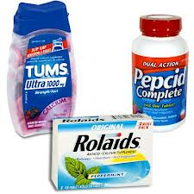
Acids and Bases in the Body
Blood must have balanced pH
Not affected by pH of foods
Regulated by buffers
Digestive system requires a highly acidic environment to digest food
Between 1.5 and 1.7 pH
Gastric acid is mostly hydrochloric acid
Antacids help neutralize stomach acid

